Slide 1


FAST
National University of Computer and Emerging Sciences Peshawar
OOP Lab # 3.1
C++ Conditional Statements Instructor: Mazhar Iqbal
DEPARTMENT OF COMPUTER SCIENCE
الذی علم بالقلم۔ علم الانسان ما لم يعلم۔

Slide 2
Contents
if statement
if-else statement
if-else if- else statement
Nested if-else statement
Conditional operator
Switch Statement
Boolean variable

Slide 3
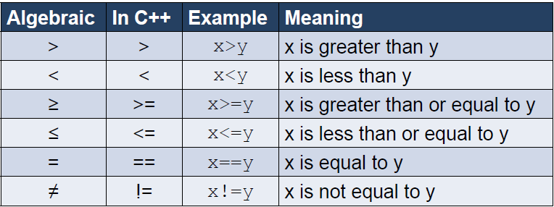
Relational Operators/comparison operators

Slide 4
Blocks of Code
Whenever we write an if statement or a loop, if there is more than one statement of code which has to be executed, this has to be enclosed in braces, i.e. ‘{ …. }’

Slide 5
Conditional Statements
Also called decision making statements decision control statements.
Decision making structures have one or more conditions to be evaluated or tested by the program, along with a statement or statements that are to be executed if the condition is determined to be true, and optionally, other statements to be executed if the condition is determined to be false.
Used to change the flow.
In these statements (conditions) order or sequence of the statements are changed.
Sometimes we need to execute a block of statements only when a particular condition is met or not met. This is called decision making, as we are executing a certain code after making a decision in the program logic.

Slide 6
Conditional Statements…
If Statement
If-else Statement
If-else if- else statement
Switch statement
Nested Statement
Use if to specify a block of code to be executed, if a specified condition is true
Use else to specify a block of code to be executed, if the same condition is false
Use else if to specify a new condition to test, if the first condition is false
Use switch to specify many alternative blocks of code to be executed

Slide 7
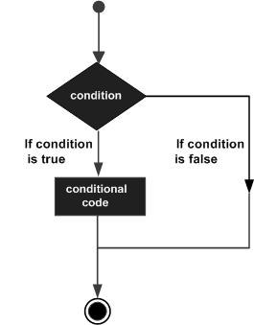
Conditional Statements…

Slide 8
1) if Statement
if statement will execute or skip or ignore a block of code depending one condition
Syntax:
if(conditional expression)
{
// Statements will execute if the Boolean expression is true
}
The statements inside if parenthesis (usually referred as if body) gets executed only when the given condition is true. If the condition is false than the statements inside if body are completely ignored.

Slide 9
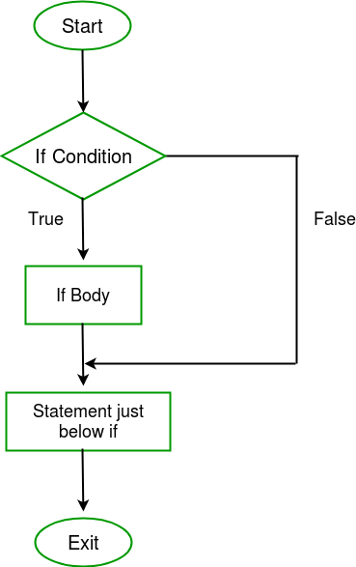
1) if Statement…

Slide 10
1) if Statement…
#include<iostream>
using namespace std; int main()
{
if (20>18)
{
cout<<"20 is greater than 18";
}
}

Slide 11
1) if Statement…
We can also test variables: #include <iostream>
using namespace std;
int main() {
int x = 20;
int y = 18;
if (x > y) {
cout << "x is greater than y";
}
return 0;
}

Slide 12
2) if else Statement
Used for making two way decision.
It will execute if block if condition is true and will execute another block (else block) if condition is false.
It will take one action if the condition is true and take another action if condition is false.
Sometimes you have a condition and you want to execute a block of code if condition is true and execute another piece of code if the same condition is false. This can be achieved in C++ using if-else statement.
This is how an if-else statement looks:

Slide 13
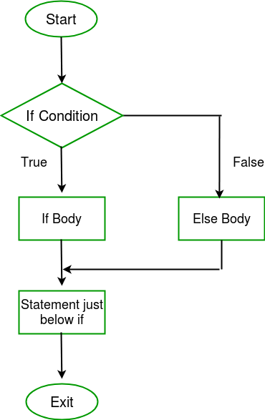
2) if else Statement…
if(condition)
{
Statement(s);
}else
{
Statement(s);
}
The statements inside “if” would execute if the condition is true, and the statements inside “else” would execute if the condition is false.

Slide 14
2) if else Statement…Example
#include<iostream>
using namespace std; int main()
{ int x=15;
int y=18;
if (x>y)
{
cout<<"x is greater than y";
}
else
{
cout<<"y is greater than x";
}
return 0;
}

Slide 15
if else Statement Tasks
Find positive and negative numbers using if else statement.
Find even and odd numbers using if else statement.
Find leap year using if else statement.
Write a C++ program which will get two numbers from user and find large number between them using if else statement.
Leap year Hints: common year has 365 days (feb 28 days)
Leap year has 366 days (feb 29 days)
year%4==0 leap year

Slide 16
3) if-else-if else Statement
This statement is used to check multiple conditions.
Used to execute one condition from multiple statements.
if-else-if statement is used when we need to check multiple conditions. In this control structure we have only one “if” and one “else”, however we can have multiple “else if” blocks. This is how it looks:

Slide 17
3) if-else-if else Statement…
if(condition_1)
{
/*if condition_1 is true execute this*/
statement(s);
}else if(condition_2)
{
/*execute this if condition_1 is not met and condition_2 is met*/
statement(s);
}

Slide 18
3) if-else-if else Statement…
else if(condition_3)
{ /* execute this if condition_1 & condition_2 are * not met and condition_3 is met */
statement(s);
}
.
.
.

Slide 19
3) if-else-if else Statement…
else {
/* if none of the condition is true then these statements gets executed */
statement(s);
}

Slide 20
3) if-else-if else Statement…
Note:
The most important point to note here is that in if-else-if, as soon as the condition is met, the corresponding set of statements get executed, rest gets ignored.
If none of the condition is met then the statements inside “else” gets executed.

Slide 21
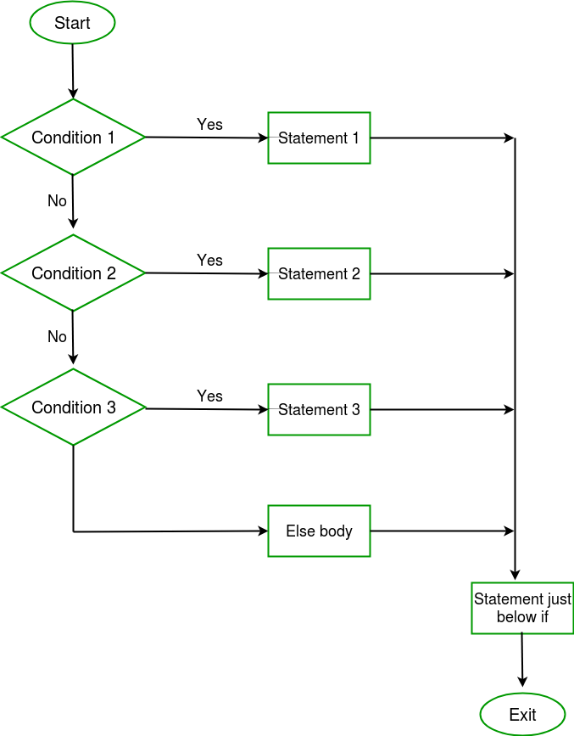
3) if-else-if else Statement…

Slide 22
3) if-else-if else Statement…
#include<iostream>
using namespace std;
int main()
{
int x=20;
if (x==10)
{
cout<<"x is 10";
}
else if(x==15)
{
cout<<"x is 15";
}

Slide 23
3) if-else-if else Statement…
else if(x==20)
{
cout<<"x is 20";
}
else
{
cout<<"sorry! x is not present";
}
return 0;
}

Slide 24
3) if-else-if else Statement…
#include<iostream>
using namespace std;
int main()
{
int number;
cout<<"Enter a number between 1 to 3:";
cin>> number;
if(number == 1)
{
cout<<"You pressed 1" <<endl;
}
else if(number == 2)
{
cout<<"You pressed 2" <<endl;
}

Slide 25
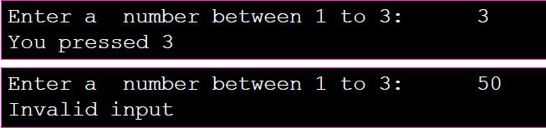
3) if-else-if else Statement…
else if(number == 3)
{
cout<<"You pressed 3" <<endl;
}
else
{
cout<<"Invalid input";
}
}

Slide 26
if-else-if else Statement Tasks
Find positive, negative and neutral numbers using multiple if statement.
Take value of temperature from user and find status of weather accordingly.
Take value of percentage from user and find grades based on percentage value.
Make a calculator using if-else-if else statement which perform the addition, subtraction, multiplication, division and remainder operations. Take values and operator from user on runtime.

Slide 27
4) Nested if statement
You can use one if or else if statement inside another if or else if statement(s).
#include<iostream>
using namespace std; int main()
{
int x=30;
int y=10; if (x==30)
{
if(y==10)
{
cout<<"x=30 and y=10";
}
}
return 0; }

Slide 28
4) Nested if statement…
#include<iostream>
using namespace std;
int main()
{
bool job; char martialStatus; int age;
cout<<"Enter Martial Status:";
cin>>martialStatus;
cout<<"Enter age:";
cin>>age;
cout<<"Enter job Status:";
cin>>job;

Slide 29
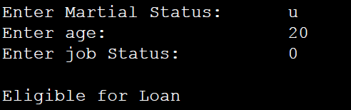
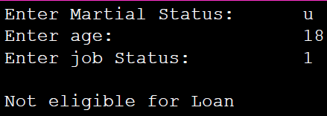
4) Nested if statement…
if(martialStatus =='u')
{
if(age <=25)
if(job ==false)
cout<<"Eligible for Loan";
}
else
cout<<"Not eligible for Loan";
return 0;
}

Slide 30
5) Conditional Operator (? :)
It is ternary operator and work on three operands.
It works like if else statement.
Syntax:
(condition) ? statement 1 : statement 2;
Statement must be single and it is the limitation of conditional operator.

Slide 31
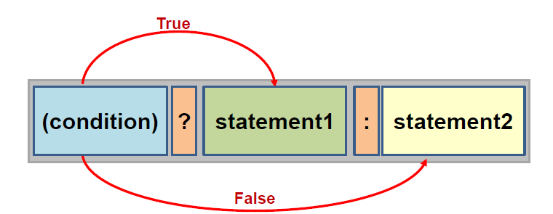
5) Conditional Operator (? :)…

Slide 32
5) Conditional Operator (? :) Example
#include<iostream>
using namespace std;
int main()
{
int n1=5;
int n2=4;
int result = (n1>n2) ? n1 : n2;
cout<<result;
return 0;
}

Slide 33
Conditional Operator (? :) Tasks
Write a C++ program which will get two numbers from user and find large number between them using conditional operator.
Find positive and negative numbers using conditional operator.
Find even and odd numbers using conditional operator.

Slide 34
Logical Operators
Used for compound condition or expression
AND (&&) ------------------->(ampersand sign)
OR (||)------------------->pip sign

Slide 35
AND (&&)
#include<iostream>
using namespace std; int main()
{
int x=30;
int y=10;
if (x==30 && y==10)
{
cout<<"x=30 and y=10";
}
else
{
cout<<"Either x is not equal to 30 or y is not equal to 10 or both are not equal";
}
return 0; }

Slide 36
OR (||)
#include<iostream>
using namespace std; int main()
{
int x=30;
int y=10;
if (x==30 || y==10)
{
cout<<"x=30 or y=10";
}
else
{
cout<<"Both are not equal means x is not equal to 30 and y is not equal to 10";
}
return 0;
}

Slide 37
6) Switch statement
Used when multiple choices are given and one is to be selected. It is like if else-if- else statement.
Used to select one several actions based on the value of variable or expression.
Switch case statement is used when we have number of options (or choices) and we may need to perform a different task for each choice.

Slide 38
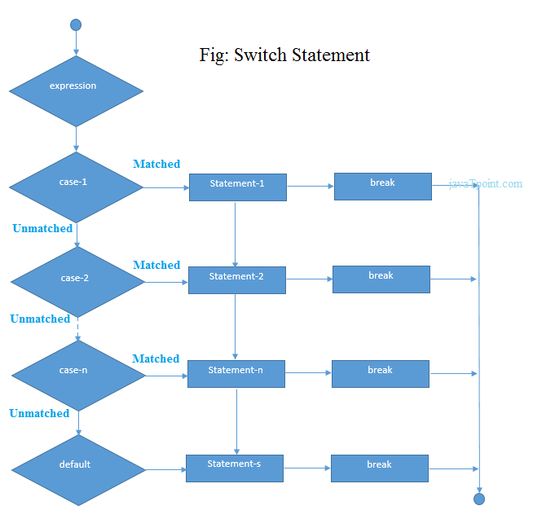
6) Switch statement…

Slide 39
6) Switch statement Syntax
switch(variable/expression)
{
case value 1:
statement(s); // code to be executed
break;
case value 2:
statement(s); // code to be executed
break;

Slide 40
6) Switch statement Syntax…
.
.
.
case value n:
Statement(s); // code to be executed
break;
default:
statement(s); // code to be executed if all cases are not matched
}

Slide 41
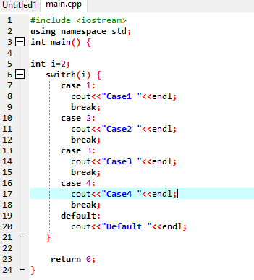
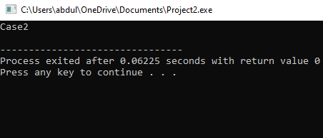
6) Switch statement Example

Slide 42
Switch statement Tasks
Make a C++ calculator using switch statement which perform the following addition, subtraction, multiplication, division and remainder value. Take value and operator from user on runtime.
Write a C++ program using switch statement which get month name from user and display month number accordingly.

Slide 43
Switch statement VS if else if
If a program contains conditions or compound conditions then we use if else if else statement.
If program contains single variable or expression then we use switch statement.
Compound conditions
if(a>b && a>c)
if)(a>b || a>c)

Slide 44
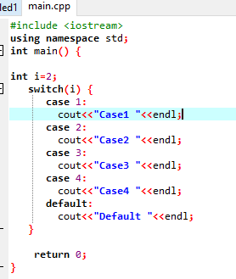
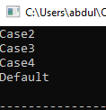
C++ Switch statement is fall through
It means it executes all statements after match if break statement is not used with switch cases.

Slide 45
C++ Switch statement is fall through…
#include <iostream>
using namespace std;
int main() {
cout<<"Enter alphabet: ";
char alphabet;
cin>>alphabet;
switch(alphabet)
{
case 'a':
case 'e':
case 'i':
case 'o':

Slide 46
Java Switch statement is fall through…
case 'u':
case 'A':
case 'E':
case 'I':
case 'O':
case 'U':
cout<<"You entered vowel";
break;
default:
cout<<"You entered consonant";
} // switch body Closed
return 0;
}
Enter alphabet: a
You entered vowel
Enter alphabet: I
You entered vowel
Enter alphabet: s
You entered consonant

Slide 47
Break Statement
The break statement is used to exit from the body of the switch structure or loop structure.
The break statement terminates the execution of the loop when it is used inside the body of the loop.
Syntax: break;

Slide 48
boolean variable
Syntax:
bool variable_name;
e.g: bool even;

Slide 49
boolean variable example
#include <iostream>
using namespace std;
int main() {
cout<<"Enter any number: ";
int number;
cin>>number;
bool even; // bool variable declaration
even =(number % 2==0);
if(even)
{
cout<<"Even number";
}
else
{
cout<<"Odd Number";
}
return 0;
}
Enter any number: 6
Even number
Enter any number: 7
Odd Number

Slide 50
Summary
Sr.No | Statement & Description
1 | if statement An ‘if’ statement consists of a Boolean expression followed by one or more statements.
2 | if...else statement An ‘if’ statement can be followed by an optional ‘else’ statement, which executes when the Boolean expression is false.

Slide 51
Summary…
3 | if...else if…else statement An ‘if’ statement can be followed by one or multiple else if statement and none of above is true then ‘else’ statement, which executes when the Boolean expression is false.
4 | switch statement A ‘switch’ statement allows a variable to be tested for equality against a list of values.
5 | nested statements You can use one statement inside another statement(s).

Slide 52
References
https://beginnersbook.com/2017/08/cpp-data-types/
https://www.geeksforgeeks.org/c-data-types/
http://www.cplusplus.com/doc/tutorial/basic_io/
https://www.geeksforgeeks.org/basic-input-output-c/
https://www.w3schools.com/cpp/default.asp
https://www.javatpoint.com/cpp-tutorial

Slide 53

THANK YOU
Thanks

